Slide 1
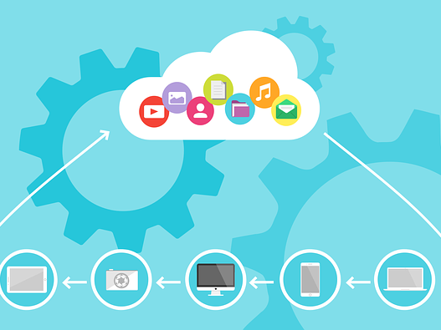
Digital Communications Strategies and Applications

Slide 2

What you’ll learn…
Choosing the right social networks and social monitoring/management platforms
Trends in digital communications and their impact on brands

Slide 3

WHERE TO START?
So how do you choose the right social media network as an individual or business?

Slide 4
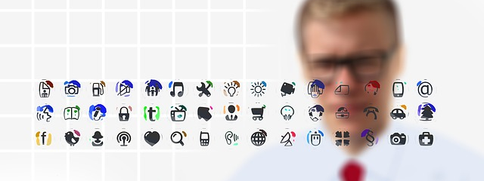
WHERE TO START?
The tools you select to use must fit with your organization’s overall communications strategy.

Slide 5

WHERE TO START?
When it comes to picking the right tool, you also have to think about the AUDIENCE you are trying to reach.

Slide 6

YOUR OPTIONS?
PINTEREST - Billed as a content-sharing service that allows members to pin or post photos, videos and other images to their pinboards.
Quick facts:
175 million total users
81 per cent of users are female
40 per cent of new signups are men; 60 per cent new signups are women
Median age of a Pinterest user is 40, however, the majority of active pinners are below 40.
Half of Pinterest users salaries are $50K or greater per year, with 10 per cent of Interesting households making greater than $125K
30 per cent of all U.S. social media users are Pinterest users.
60 per cent of Pinterest users are from U.S.

Slide 7

YOUR OPTIONS?
SNAPCHAT – Image messaging and multimedia that disappears
Quick facts:
More than 300 million monthly active users
1 million Snaps are created everyday (Photos & Videos)
Average time spent per user on daily basis = 30+ minutes
Number of Snapchat users who upload photos = 65 per cent
Number of Snapchat daily video views = More than 10 billion
71 per cent of Snapchat users are under 34 years old
Roughly 70 per cent of Snapchat users are female
People under the age of 25 use Snapchat for 40 minutes on average every day, more than Instagram's latest stat for same demographic

Slide 8

Your Options?
LinkedIn – It’s the professional networking site.
Quick facts:
500 million total users
Percentage of users that use LinkedIn daily: 40 per cent
Number of New LinkedIn new members per second: Two
70 per cent of LinkedIn users are from outside of the U.S.
40 million students and recent college graduates on LinkedIn.
There are 57 per cent of male users and 44 per cent female users on LinkedIn
13 per cent of Millennials (15-34 years old) use LinkedIn
44 per cent of LinkedIn users earn more than $75,000 a year

